Slide 1
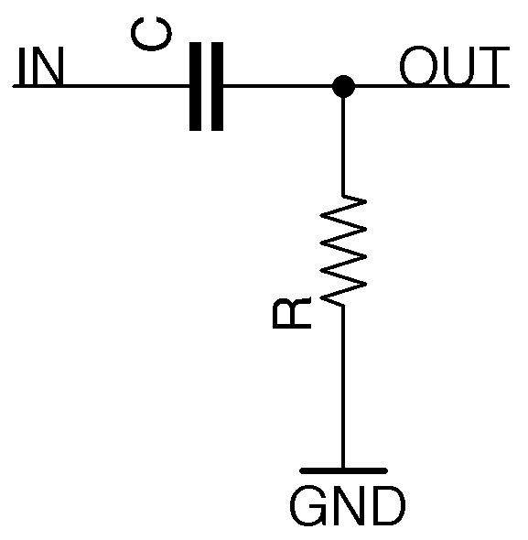
A Resistor-Capacitor High-Pass Filter
RBT125
UAT
James McCormick

Slide 2
Description of the circuit
An RC high-pass filter, also known as an RC Differentiator, is a simple analog filter that allows high frequencies to pass but attenuates lower frequencies. The input signal flows through the capacitor then into a parallel resistor to the output. By using this arrangement the capacitor will block any of the low frequencies by acting as an open circuit if the oscillations remain above a minimum speed. The attenuation created using this method creates a frequency dependent voltage divider. At low frequencies, the capacitor acts as a very high resistance, so the signal is attenuated a lot. At higher frequencies, the capacitor has less resistance, so the signal is attenuated less.
The cutoff frequency of the filter is determined by the equation fc = 1/2πRC

Slide 3
Where is the circuit used?
Imagine sitting in your car, it’s raining, you have the radio playing, your phone is plugged into the cigarette lighter to charge. Traffic is lighter because of the rain, you pull up to a red light and as the wipers flick on and off clearing your view, a song comes on that makes your head bob just in time to see someone run the red light and cause an accident! The sudden event causes your heartbeat to change rhythm - causing your pacemaker to discharge. While this scenario may seem vaguely related, there is an electronic circuit involved that everything mentioned had inside it: a Resistor-Capacitor High-Pass Filter!
This type of circuit has several uses but is commonly found in:
Circuits that need to filter out and protect against unwanted frequencies.
During conversions from AC to DC voltages.
Controlling the windshield wipers on a car.
Controlling traffic lights.
Controlling heart rate by charging and discharging pacemakers.
Creating delays in secondary circuits.
Pulse shaping
Edge detection
Signal processing
But the uses are almost limitless as this component combination is essentially a core building block in the creation of analog circuits.

Slide 4
Advantages of the circuit
An advantage of using an RC circuit is that the higher the time constant of the circuit, the output will be closer to a perfectly smooth DC output. Using an RC High-Pass helps to mitigate the down time experienced when a capacitor needs to charge and helps to filter and smooth out the frequency that is output. This type of circuit can also convert outputs for processing, for example converting triangle waves into square waves. It is also capable of being used to detect input pulses to trigger secondary outputs. This combination can also be used to measure and respond to inputs and adapt to filter out unwanted noise or increase the frequency of responses by the connected circuit. Modern day pacemakers are able to adjust themselves to account for physical or strenuous activities and modify the signals sent to the heart to increase or decrease blood flow, accordingly. The flexibility of this combination for filtering, allows for unlimited number of uses across almost every walk of life, the only limit is your imagination.

Slide 5
Disadvantages of the circuit
The disadvantages of using this type of circuit include:
The need for a stable power supply.
If not correctly calculated, it can introduce noise into the system.
Limited frequency ranges.
Typically have a temperature coefficient of 1 - 100 microvolts per degree in Celsius.
Prevent the amplification of DC currents withholding needed power for an analog amplifiers headroom as well as causing damage and creating waste heat at the loudspeaker coil.
When calculating the needed components, if the math is not done correctly, you can filter out the desired frequency instead of the extra noise that was intended. There is less leeway when it comes to the passthrough and cutoff ranges this combination can provide. There is also a measurable amount of heat created and the components are more susceptible to damage and shortened life spans, especially when presented with an unstable power source. Another noteworthy disadvantage is, when you start using other variations of high-pass filters or larger scale versions the cost can be prohibitive.

Slide 6
Variations of the circuit
The main variation of this circuit type is the one created to have the opposite effect - the Resistor-Capacitor Low-Pass filter, which can also be called an RC Integrator. The main purpose of the RC Integrator is to filter out the high frequencies while still allowing the low ones to pass. Effectively providing the reversed effects of a Resistor-Capacitor High-Pass filter.
Other variations of a high-pass filter include:
High Pass R-C Filter Circuit
High Pass R-L Filter Circuit
Inverted L type High-Pass-Filter Circuit
T- Type High-Pass-Filter
π Type High-Pass-Filter
High-Pass-Filter using Op-Amp
Butterworth High-Pass-Filter

Slide 7
Reference Slide
Arrow electronics. (2018, October 9). What is an RC Circuit? RC Circuit Formula & Filtering. Arrow Electronics. Retrieved February 11, 2024, from https://www.arrow.com/en/research-and-events/articles/rc-circuit-basics-low-high-pass-filtering-and-formulas
LibreTexts - Physics. (2022, September 12). 10.6: RC Circuits. Physics LibreTexts. Retrieved February 11, 2024, from https://phys.libretexts.org/Bookshelves/University_Physics/University_Physics_(OpenStax)/Book%3A_University_Physics_II_-_Thermodynamics_Electricity_and_Magnetism_(OpenStax)/10%3A_Direct-Current_Circuits/10.06%3A_RC_Circuits
Brennan, E. (2021, November 19). RC Circuit Formula Derivation: Solving the Differential Equation Using an Integrating Factor. Medium. Retrieved February 11, 2024, from https://medium.com/math-simplified/rc-circuit-formula-derivation-solving-the-differential-equation-using-an-integrating-factor-ea3e37f1f4f6
ElProCus. (2013-2024, 1 1). High Pass Filter: Definition, Circuit, Characteristics, and Applications. ElProCus. Retrieved February 11, 2024, from https://www.elprocus.com/what-is-a-high-pass-filter-circuit-diagram-characteristics-and-applications/
https://praterma2.github.io/cards/src/rc_hpf.html
., M. (2024, 1 1). High Pass Filter - Types, Applications, Advantages & Disadvantages. electricalfundablog.com. Retrieved February 11, 2024, from https://electricalfundablog.com/high-pass-filter/

